Slide 1
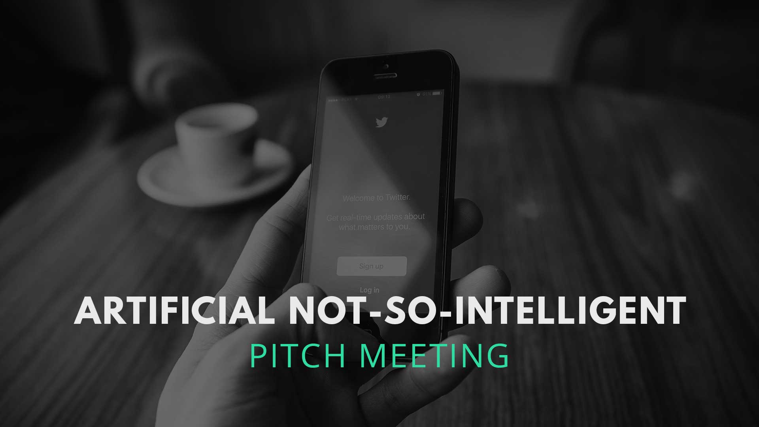
IS434 Social Analytics
Group 1
Done by: Chia Hui Min, Koh Wei De John, Lee Qixian, Lee Weng Ho Mervyn & Ong Ming Hao

Slide 2
GOALS OF THIS PRESENTATION
WHAT ARE THE GOALS OF THE PRESENTATION?
To have a deeper understanding of User Experience (UX)
To showcase the journey that Ox-Automated-Testing has gone through
Understanding the different principles of UX

Slide 3
THE APPROACH
WHAT WE ARE PLANNING TO DO ( WEBCRAWLER + DATA CLEANING)
I can create a web crawler for twitter + I can do the cleaning. i.e. removal of any biasness, spell checker, remove stop words, etc.
* What to crawl?

